Slide 2
Framing Science
Science Communication
Types
How does the public view science?
What are the barriers and how do we overcome them?
Climate Change Communication
Unique? Challenges
Best Practices/Advice for Communicators

Slide 3
SCIENCE Communication
Scholarly Communication
Science Education
Science Journalism
Risk Communication
Science-based Entertainment
Social Learning/Public Participation

Slide 4
American Attitudes toward science
7 out of 10 Americans see scientific research as more positive than negative for society (NSF)
Americans with more education, income and scientific knowledge held a stronger belief in the benefits of science (NSF)
Americans also had confidence and trust in scientists- only exceeded by the military (NSF)
American were near average in comparison to other counties in their belief that science can solve environmental problems (~20% agree, ~50% disagree)

Slide 5
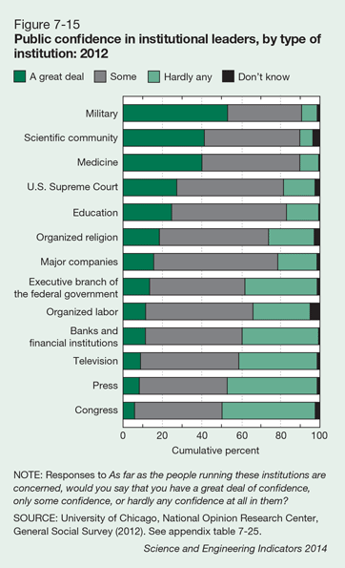

Slide 6
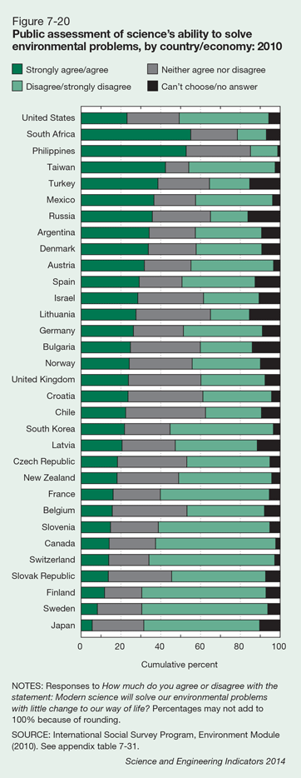

Slide 7
Barriers to Communication
Science Literacy and Numeracy?

Slide 8
Adult Science Understanding
American correctly answered 5.8 out of 9 science questions (National Science Foundation)
Levels of factual knowledge in the United States are comparable to those in Europe and are generally higher than levels in countries in other parts of the world. (NSF)
Survey of numeracy in adults, across all countries in a study, 8.1%-31.7% are proficient only at the lowest level of numeracy- US is 28% (OCED)

Slide 9
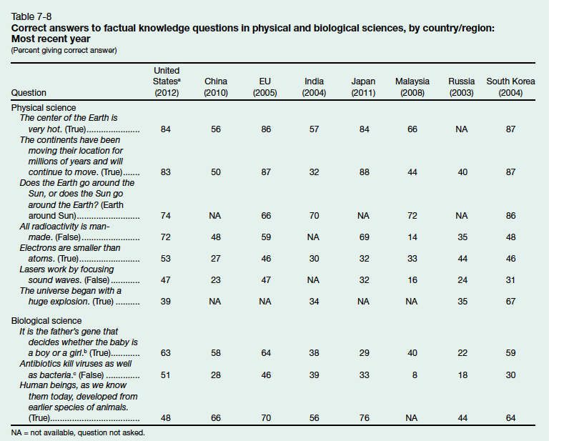

Slide 10
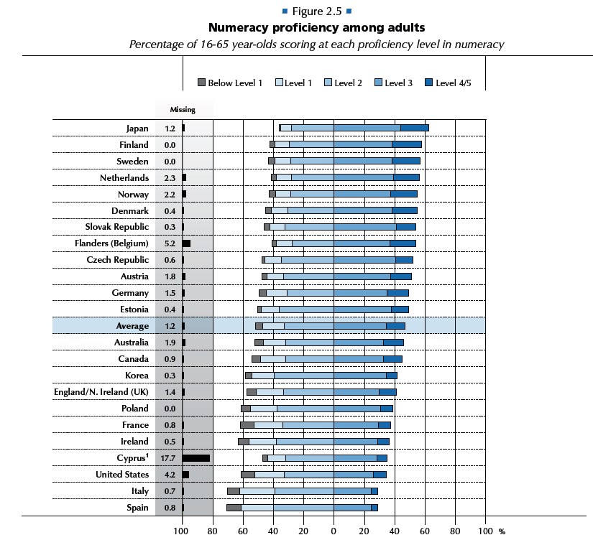

Slide 11
Barriers to Communication
Discerning good sources of Information
Evaluating an unfamiliar risk

Slide 12
Science Communication- Where
More people are using the internet for science information, but most of the information sources were on-line newspapers (33% got science from newspapers) (NSF)
When asked where they would go to seek information 63% said the internet (NSF)
80% of people that have gotten science information on line have also used the internet to fact check, but also use other sources (Pew)

Slide 13
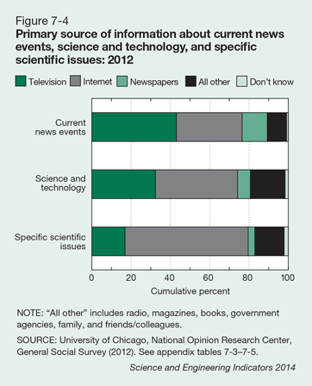

Slide 14
Internet Sites Used (PEW, 2006)
When asked whether they had ever gone to websites where the content is predominantly about science, half (49%) of internet users said they had been to at least one of the following sites.
23% of internet users have been to NationalGeographic.com.
23% have been to USGS.gov, the main website of the U.S. Geological Survey, which is the main U.S. government site for Earth-science information.
19% have been to NASA.gov.
14% have been to the Smithsonian Institution website.
10% have been to Science.com.
9% have been to Nature.com.

Slide 15
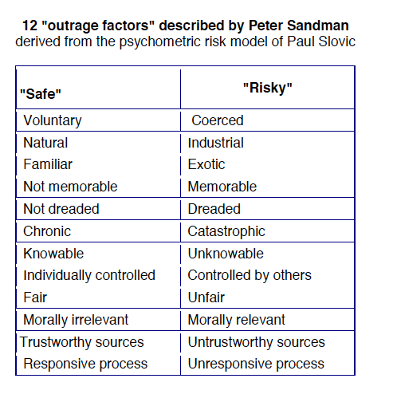
Risk Perception
Risk= Hazard + Outrage

Slide 16
Barriers
Beliefs. Identity or worldview conflict with accepted science-based truths or message
Evolution
Vaccines
Climate change

Slide 17
References
National Science Board. 2014. Science and Engineering Indicators 2014. Arlington VA: National Science Foundation (NSB 14-01).
OECD (2013), OECD Skills Outlook 2013: First Results from the Survey of Adult Skills, OECD Publishing.
http://dx.doi.org/10.1787/9789264204256-en
Pew Internet and Life Project, 2006, The Internet as a Resource
for News and Information about Science. http://www.pewinternet.org/2006/11/20/the-internet-as-a-resource-for-news-and-information-about-science/

Slide 18
WebSites
http://environment.yale.edu/climate-communication/
http://www.climatechangecommunication.org/http://www.culturalcognition.net/
http://climaterealityproject.org/press
http://www.skepticalscience.com/

